Slide 1


Limerick · Trondheim · Alba Iulia · Písek · Sestao · Smolyan · Võru
A Smart City Ecosystem enabling
Open Innovation
I4CS 2019 | 25.06.2019
Dirk Ahlers (NTNU) | Leendert Wienhofen (TK) | Sobah Abbas Petersen (NTNU) | Mohsen Anvaari (ITARK)
http://cityxchange.eu/
This project has received funding from the European Union’s Horizon 2020 research and innovation programme under grant agreement No 824260.

Slide 2


Slide 3

[http://trondheim2030.no/2015/11/09/ny-tredimensjonal-modell-av-trondheim-gjor-det-enklere-a-planlegge-framtidas-by/]

Slide 4
Background

Slide 5
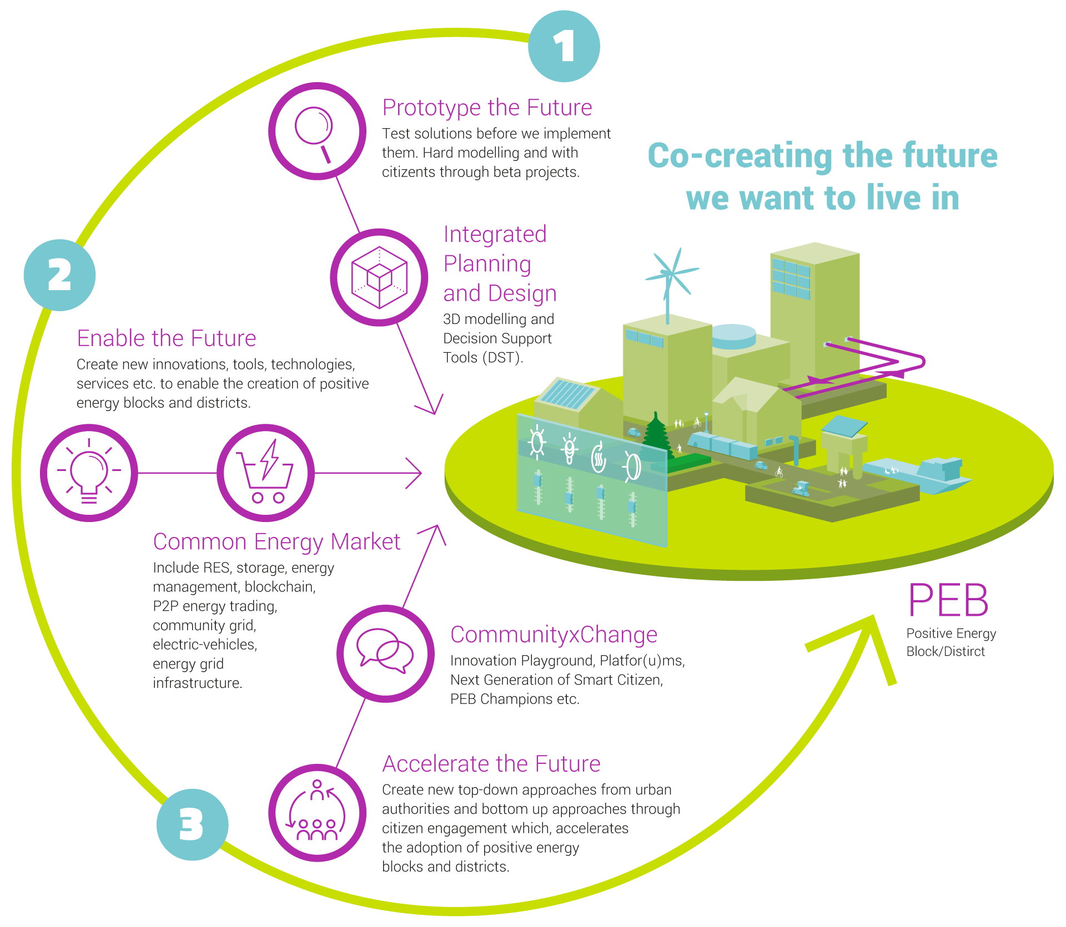
City-Driven System Transition towards Positive Energy Blocks

Slide 6

Consortium

Slide 7
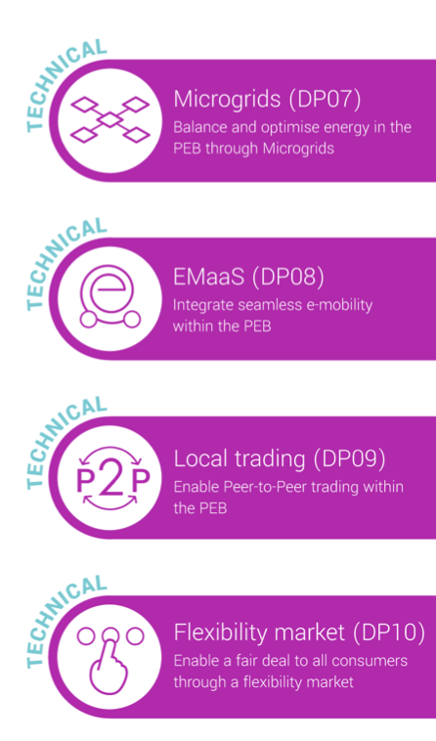

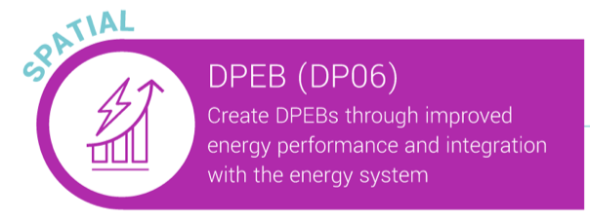
Demo Projects:
Technology

Slide 8
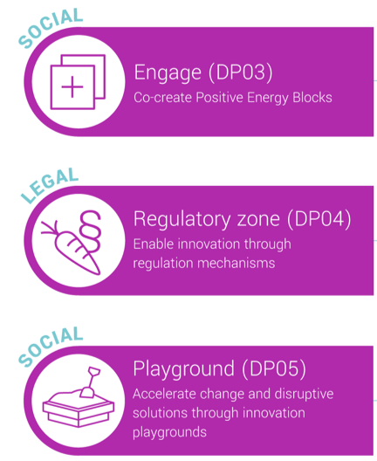

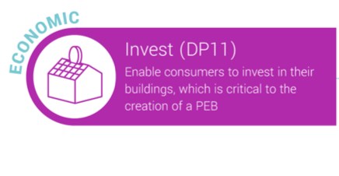
Demo Projects:
Community Engagement and Scaling

Slide 9
Approach

Slide 10
Challenge
Flexible, open, collaborative, transferable, replicable smart city ecosystem
Not only municipal system, but open system approach
Integrating many partners/suppliers and systems
Handling complexity
Working across silos
Boundaries of smart city systems
Balancing technical needs with societal benefit
City as a lab

Slide 11
Technical Objectives
development and deployment of PEBs,
integration of local distributed renewable energy sources, and energy storage;
connection of buildings and building systems to energy communities and markets;
optimized energy system operation;
connection to energy and district heating systems;
smart metering;
integration of electric vehicles;
better mobility solutions by offering eMaaS;
integrated planning and design;
digital platforms for community and stakeholder engagement;
integration with city systems;
open innovation supported by open data, hackathons, prototyping, etc.;
monitoring and evaluation of the project through KPI data processing and analysis;

Slide 12




Open Innovation
Co-creation and open innovation as a main principle
Citizen Participation
Outreach
Open Data and Systems
“Open by Default”
Building the project on transparency and openness
Inter- and extra-project collaboration and learning
Open Research Data Pilot and Open Access

Slide 13
Quadruple Helix Innovation Model
Method used in Innovation, Urban Planning/Development, Citizen engagement
Co-Creation and Open Innovation
Involvement and collaboration of relevant actors
Structural changes beyond any one segment
Smart city means involvement of all stakeholders in urban innovation, knowledge sharing, collaboration
Participatory Innovation
Industry
Academia
Civil Society
Government

Slide 14
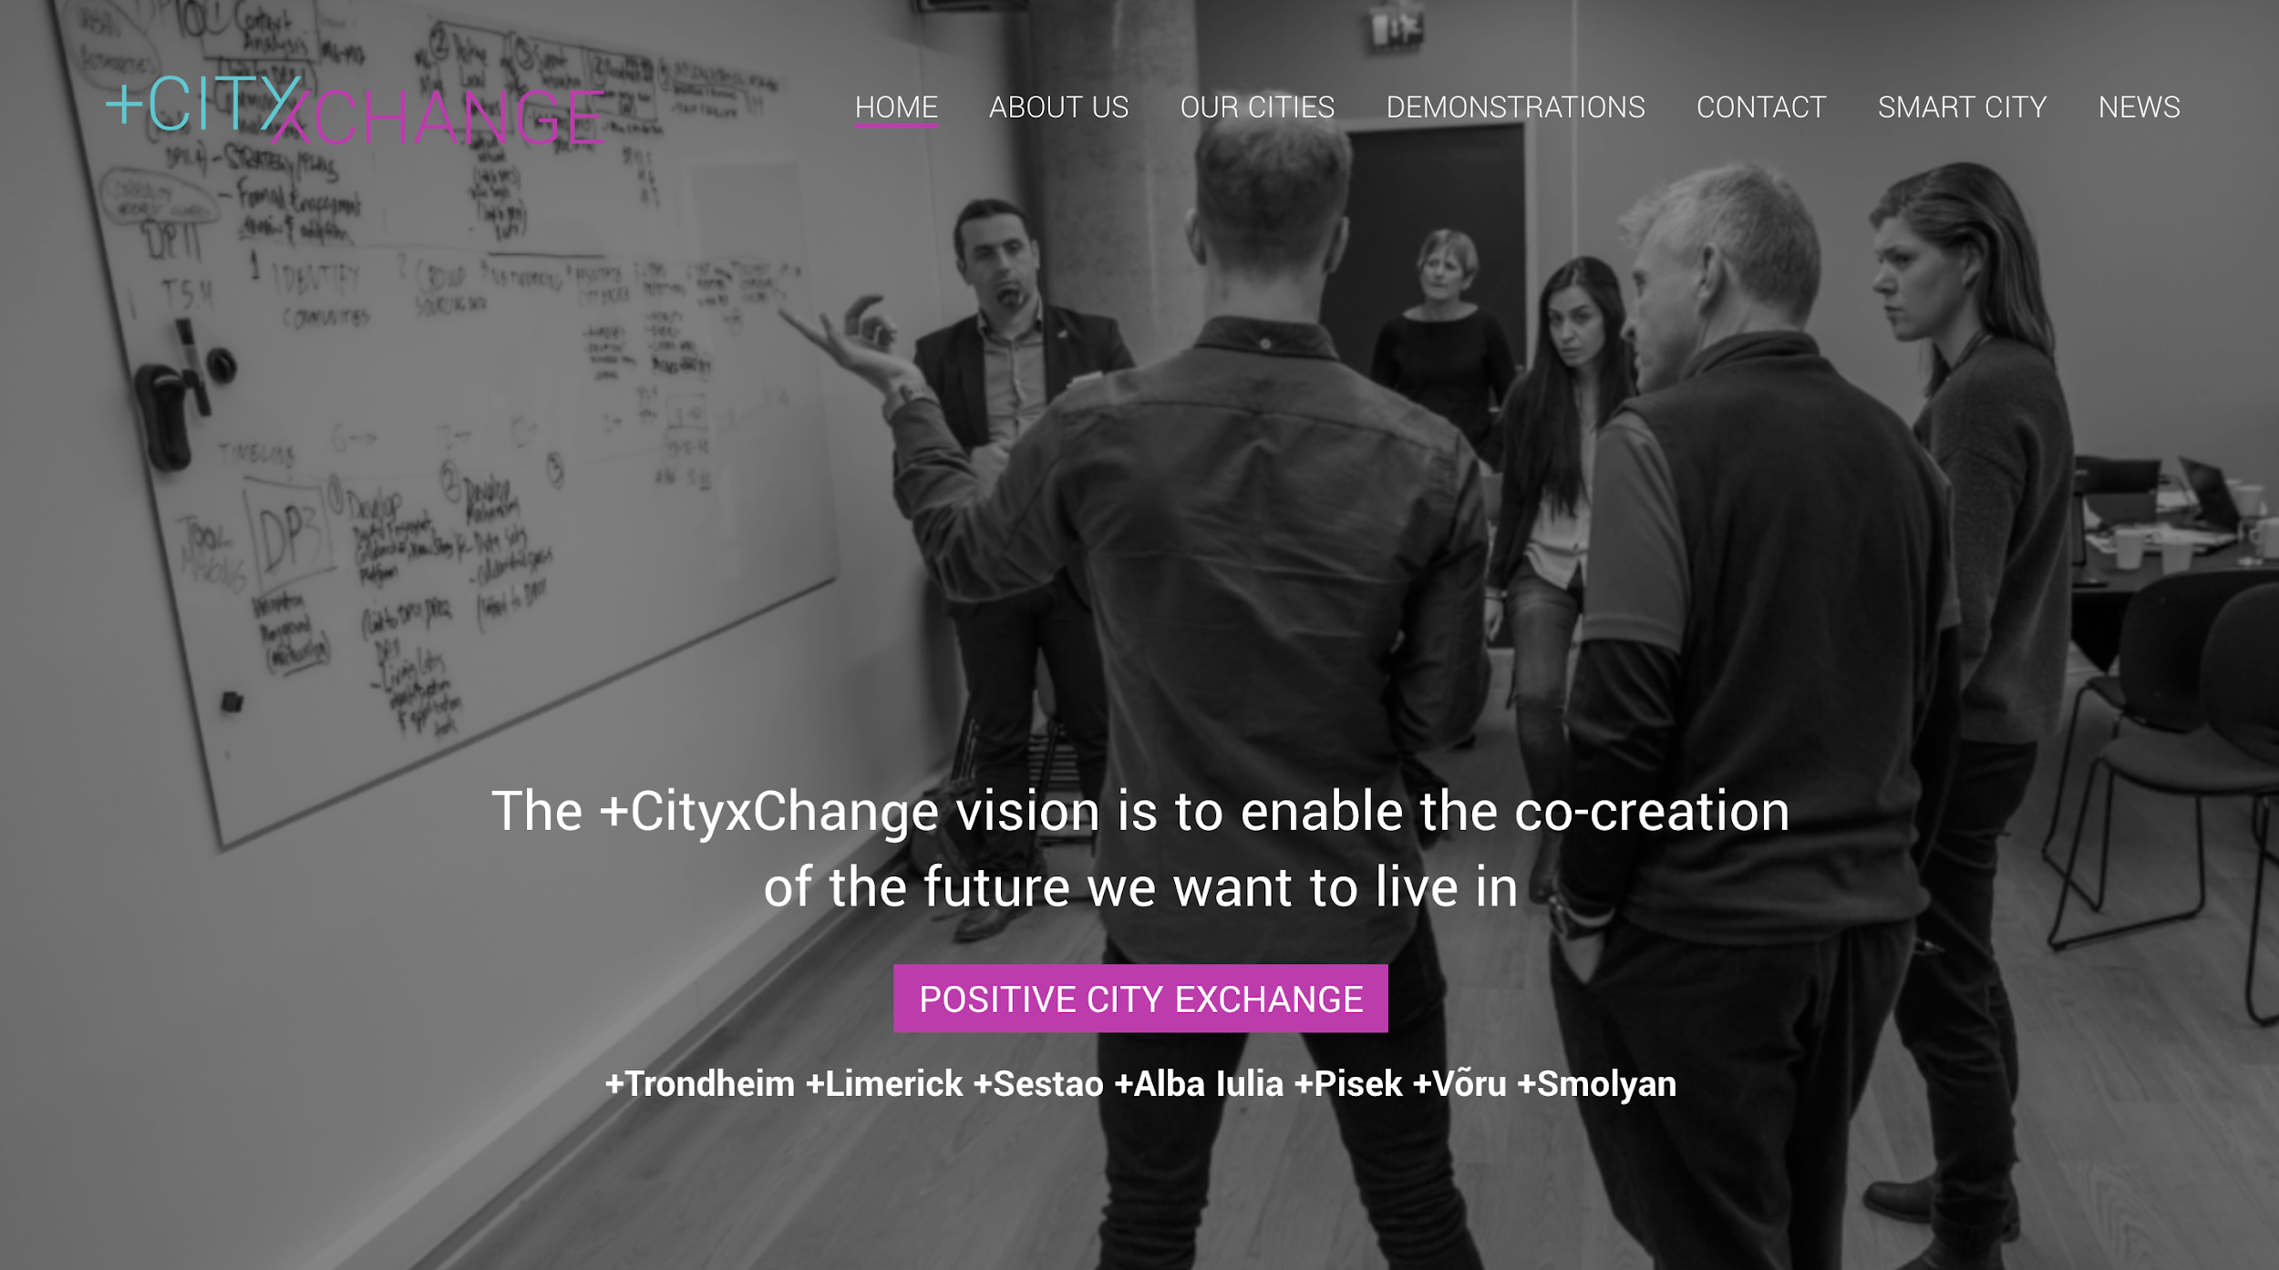

Slide 15
Actors and context boundaries
Company ...
Company n
Company 4
Smart City
European Actors
Company 3
Company 2
Municipality
National Actors
Company 1
Citizens
City networks

Slide 16
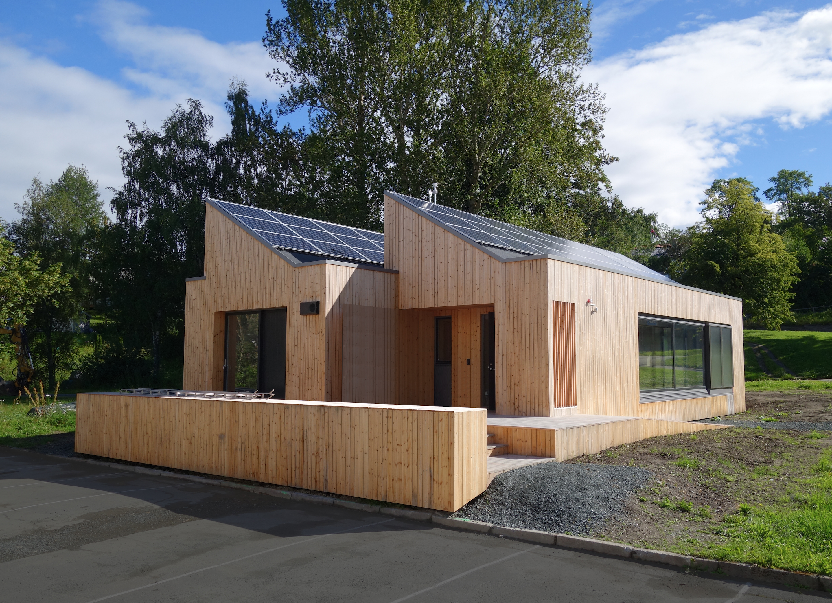
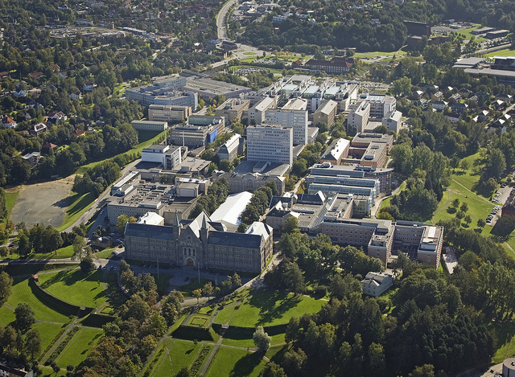
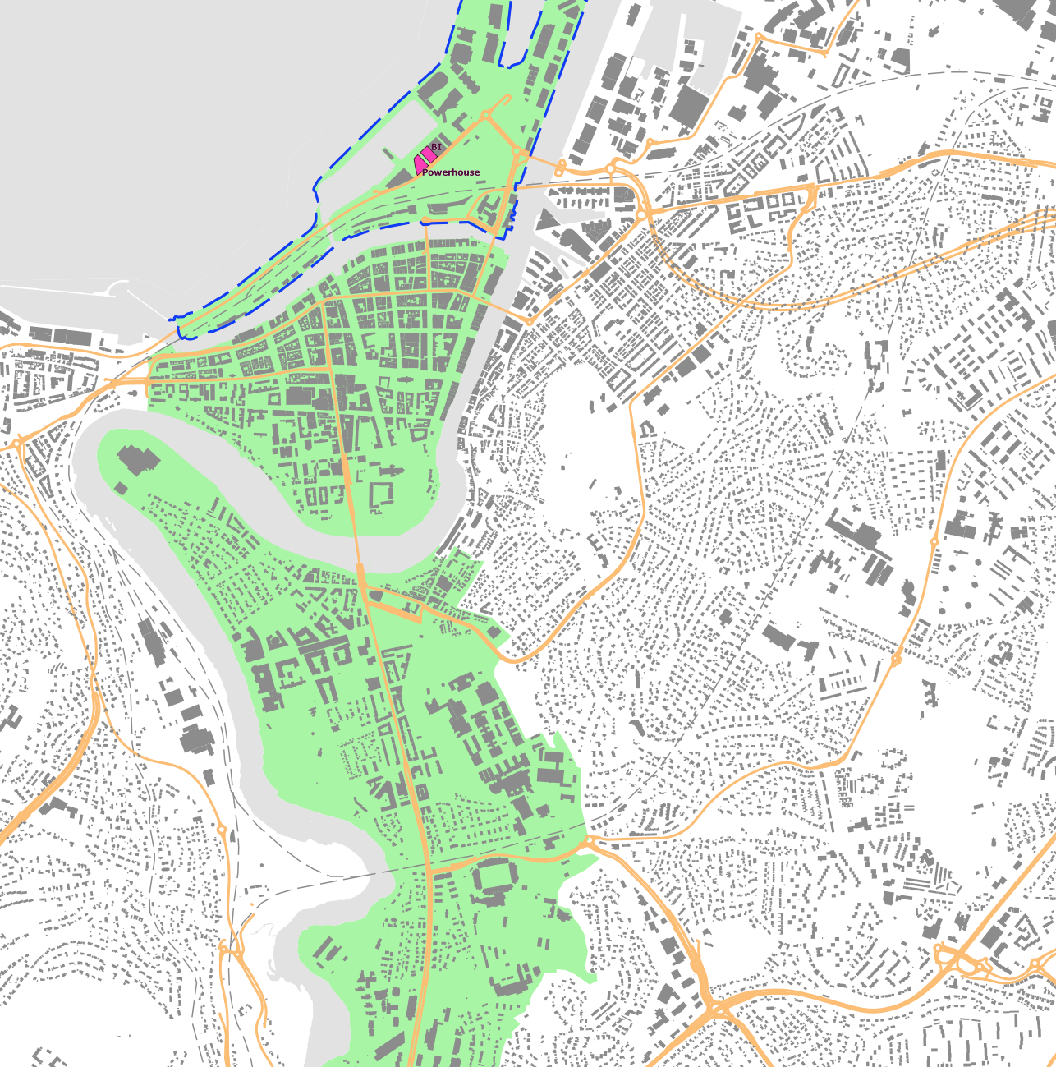
If Enterprises were cities...
If cities were enterprises...
System Architecture
Portfolio Architecture
Enterprise Architecture

Slide 17
Smart City Evolution
External and internal constraints, options, changes
City needs and strategy
Technological constraints and opportunities
City Evolution, City Systems Evolution
City
ICT/EA
Urban Renewal, City Development, City Redevelopment, Urban Innovation
Architecture Evolution and Adaptation, Development and Maintenance
Smart City Co-Evolution
[adapted from ITU-T, Setting the framework for an ICT architecture of a smart sustainable city (SSC-0345), 2015]

Slide 18
Initial Results

Slide 19
Enterprise Architecture use
With adaptations, EA can fit Smart City ecosystems
EA as
Decision-support and portfolio management (and documentation)
Joint understanding
Integration and interoperability
Quality assurance
Communication and replicability

Slide 20
Principles and Guidelines
Loose coupling of components, distributed service-oriented architecture, no central platforms
EA view to include the whole city context
Interoperability through open standards
Replicability
Data governance
Open by default, open data, open innovation, citizen engagement
Opening up and connecting silos
Reuse of existing knowledge

Slide 21
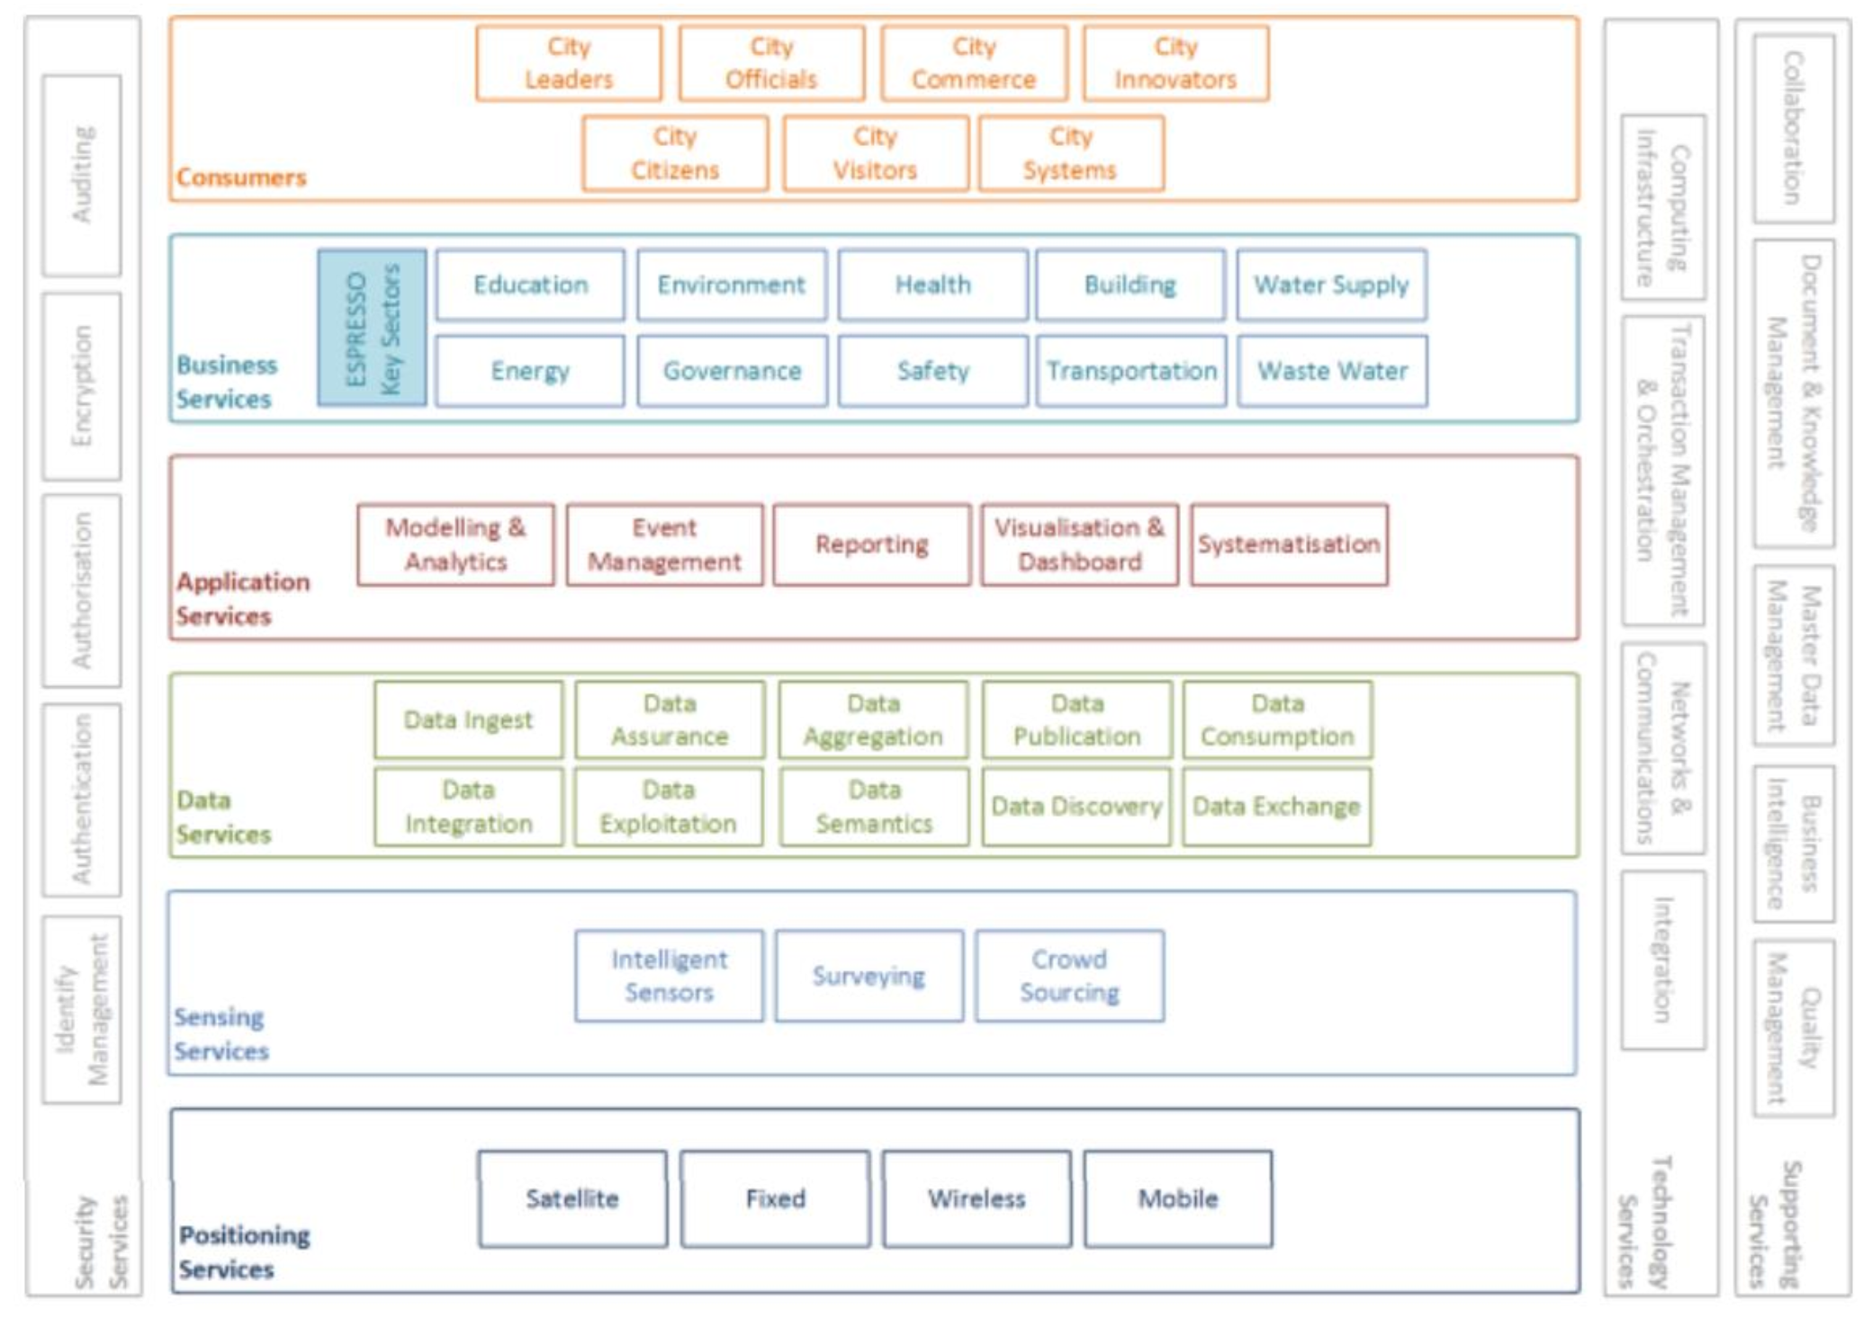

Espresso Smart Cities Reference Architecture
[Espresso: D4.2.1 Smart City reference architecture report, 2016]

Slide 22
+CityxChange ecosystem concept

Slide 23
Conclusions
Open Innovation needs open systems and data
Openness, interoperability, replicability are main concerns
Challenge to find the right abstraction level
Different views necessary
Showcase benefits and get buy-in for all partners
City-driven innovation

Slide 24
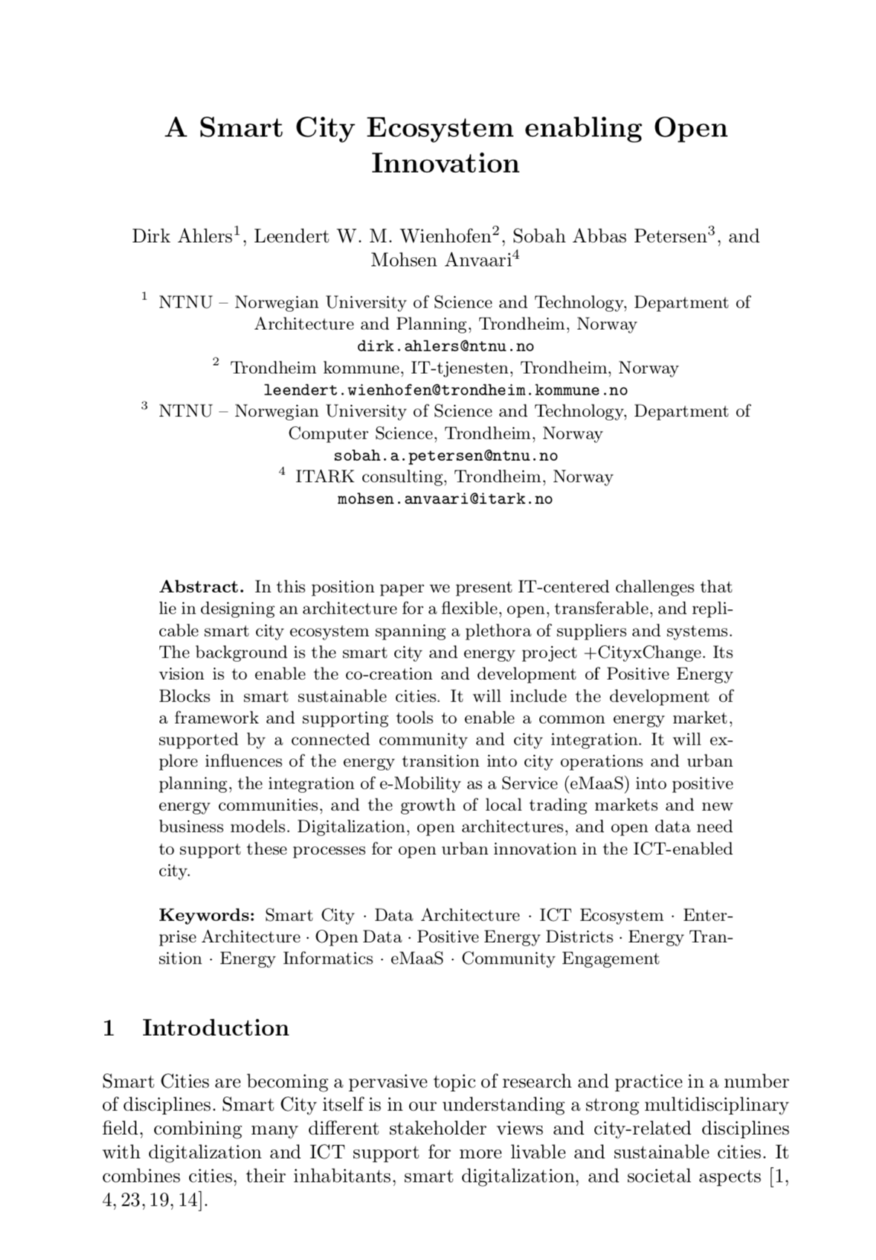

Q&A
Dirk Ahlers
dirk.ahlers@ntnu.no
https://www.ntnu.edu/smartcities
Leendert Wienhofen,
Sobah Abbas Petersen,
Mohsen Anvaari
Twitter @plusCities
Website: cityxchange.eu
Mail: info@cityxchange.eu
Published under CC-BY4.0 Creative Commons Attribution, except where otherwise noted. https://creativecommons.org/licenses/by/4.0/
Notes:
We were talking about 3 things above. We promise also 3 things: 1) Fights, 2) Insane amounts of work, 3) Lots of fun

